Slide 1
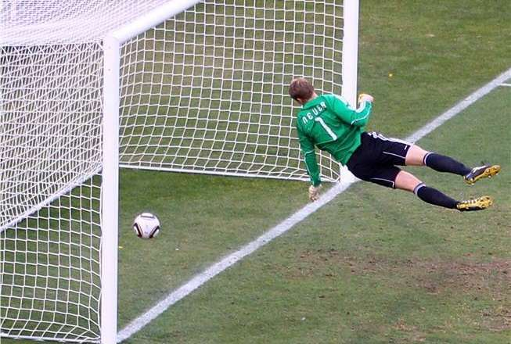
Neighborhood referee app Goals, targets and key idea presentation
GOAL!!!
Course: Multimedia Algorithms and Machine Learning in Python Environment
Lecturer: Yakir Menahem
Students: Ben Bukai, Ben Lahav

Slide 2
MAIN goals
Fully understanding of location of lines in an image algorithms (especially hough transform)
Mostly self-implementation and less counting of opencv functions (must not waste much time)
Focus on main solution and not UI/UX

Slide 3
TARGETS
Useful - a product for a real life problem.
Diversity – using algorithms to find more shapes than a line.
App speed - Reducing time-complexity with probalistic Hough Transform

Slide 4
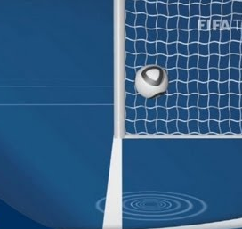
Main idea
App that can help amateur friendly sport games between friends to decide if there was a goal.
This app reduce fights between friends and we call it by the Nickname: “low cost VAR”
GOAL!!!

